Slide 1

Welcome to
AIR
CE/AE/EnSci 524

Slide 2
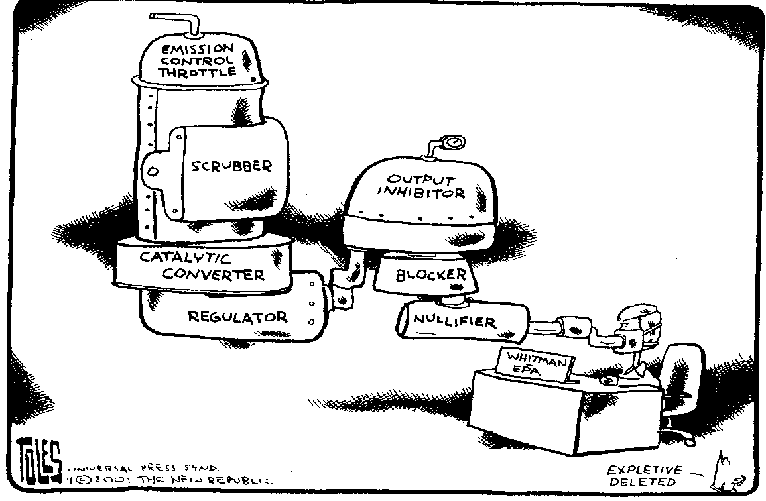
Air Pollution CE/AE 524
An introduction
By J. (Hans) van Leeuwen

Slide 3



Instructors
Class Meeting Time: Mon and Thu 1:30-3pm, 316 Town
Instructors
Dr. van Leeuwen
476 Town Engineering
leeuwen@iastate.edu
Dr. Koziel
3103 NSRIC
koziel@iastate.edu
Dr. Hallmark
402 Town Engineering
shallmar@iastate.edu

Slide 4
Source material
Required handbook: Wark, K, Warner, CF and Davis, WT (1998) Air Pollution – its origin and control. Addison-Wesley ISBN 0-673-99416-3
Other material prescribed:
Masters, GM (1998) Introduction to Environmental Engineering and Science, 3rd Ed. Prentice Hall, ISBN 0 – 13 – 155384 – 4
Chapter 8 – Global Warming
Other material recommended:
Davis, ML and Masten, SJ (2004) Principles of Environmental Engineering and Science, 3rd Ed. McGraw-Hill, ISBN 0-07-119449-5
Chapter 15 – Noise Pollution
The relevant chapters from these two sources will be made available for copying by students.

Slide 5
Module A
Week of | Mon 1:30-3 | Thu 1:30-3 | Text (Day1/Day2) | Instructor (Day1/Day2)
Jan 10 | Introduction | Sources and effects of air pollutants | Ch 1, Wark et al. | Van Leeuwen Koziel
Jan 17 | Federal Legislation | Meteorology | Chapter 2 & 3 Wark et al. | Koziel Van Leeuwen
Jan 24 | Odor | Noise Pollution | Ch 15 Davis & M | Koziel/van L
Jan 31 | Dispersion | Dispersion | Chapter 4, Wark et al. | Hallmark
Feb 7 | Particulates | Global Warming | Chapter 8, Masters | Van Leeuwen
Feb 14 |  | Exam A

Slide 6
Module B
Week of | Mon 1:30-3 | Thu 1:30-3 | Text | Instructor
Feb 7 |  | Global Warming | Ch 8, Masters | Van Leeuwen
Feb 14 | Global Warming | Exam A | Ch 8, Masters | Van Leeuwen
Feb 21 | Photochemical Reactions | Volatile organic compounds | Notes Ch 8 + Wark | Van Leeuwen Koziel
Feb 28 | Flue gas treatment | Air sampling and analysis | Chapter 5/6 Wark/ Notes | Van Leeuwen Koziel
Mar 7 | Air sampling and analysis | Indoor air quality CO generation | Notes | Koziel Van Leeuwen
Mar 14 | Spring Break
Mar 21 | Indoor air quality | Exam B | Notes | Koziel

Slide 7
Modules D and E
March-April | Aerial Emissions from Agriculture | Module E | Notes | Koziel
April | Mobile Sources | Not on offer in 2011 | Notes | Hallmark
April | Industrial Air Pollution Control | Module D | Chapters 6/7, Wark | Van Leeuwen
April 19 | Term papers
April 26 | Students present
May 3 | Final Exam Week (if needed)

Slide 8
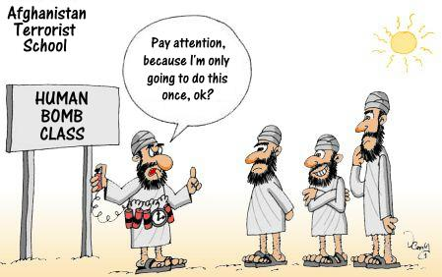

Slide 9
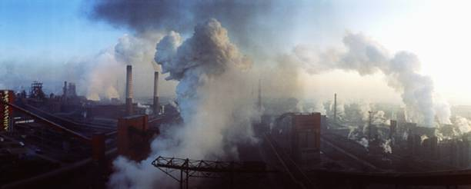
Aggravated air pollution - industry

Slide 10
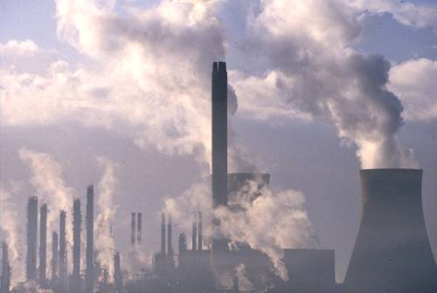
Aggravated air pollution – industry II

Slide 11
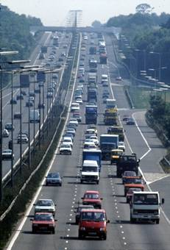
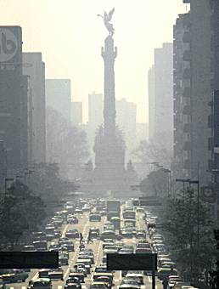
Transportation related causes of air pollution

Slide 12
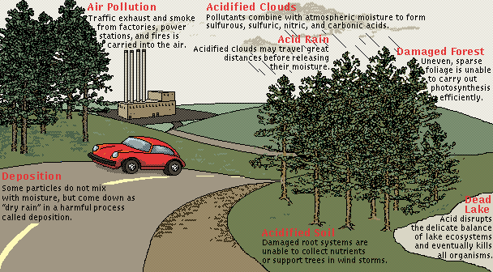
SOx and NOx pollution

Slide 13
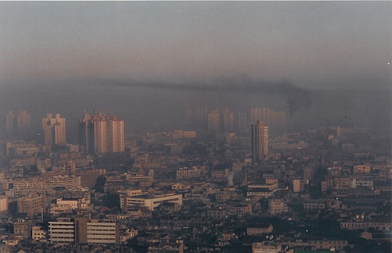
Smog over Los Angeles

Slide 14
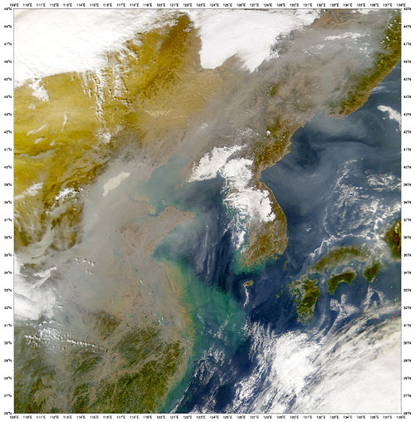
Smog over the Sea of Japan

Slide 15
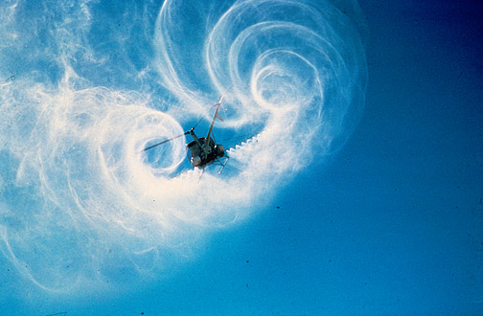
Aerial spraying

Slide 16
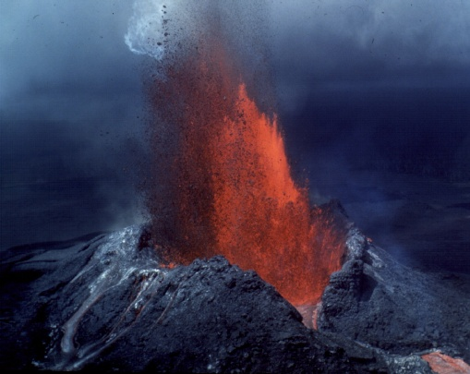
Natural sources

Slide 17
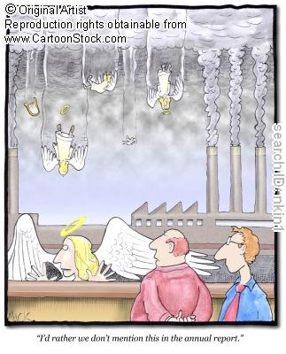
Silent polluters

Slide 18

Climate change

Slide 19

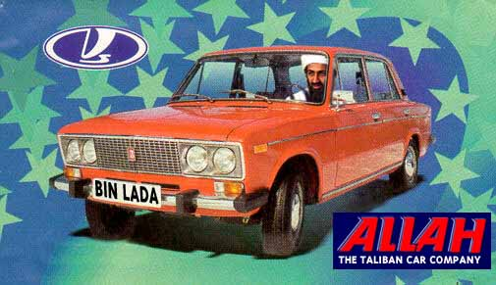
KABUL

Slide 20
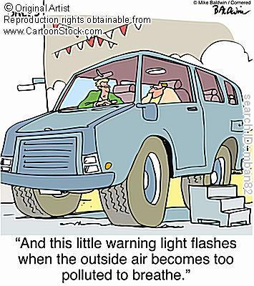
Overindulgence

Slide 21
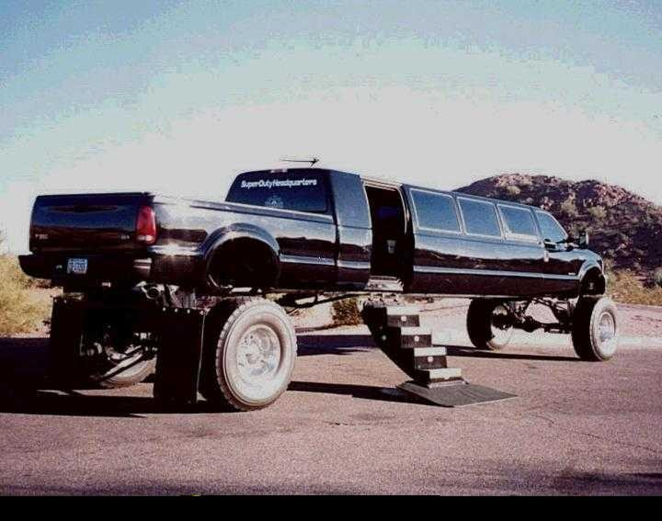
Overindulgence

Slide 22
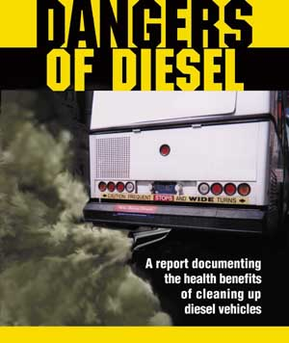
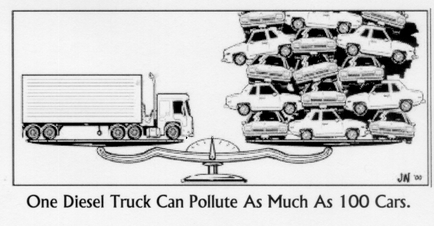

Slide 23
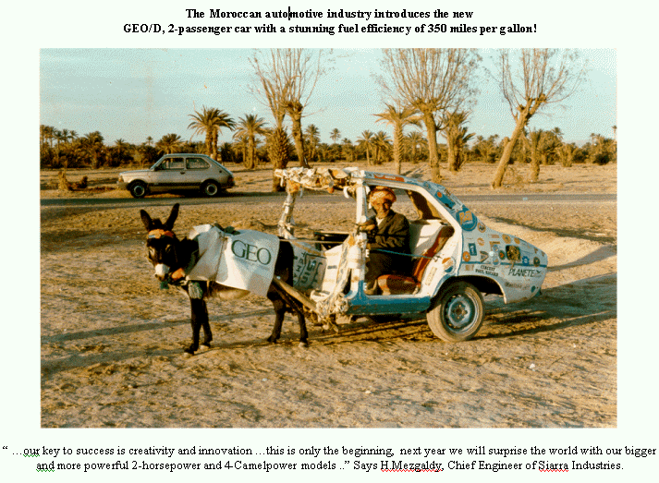
Under indulgence?

Slide 24
Passenger car
emissions ratings
HC
CO
NOx
HC CO NOx
Transitional Low-Emission Vehicle(TLEV)
50%
NR
NR
Low-Emission Vehicle (LEV)
70%
NR
50%
Ultra-Low-Emission Vehicle (ULEV)
85%
50%
50%
Super-Ultra-Low-Emission Vehicle (SULEV)
96%
70%
95%
Zero-Emission Vehicles (ZEV)
100%
100%
100%

Slide 25

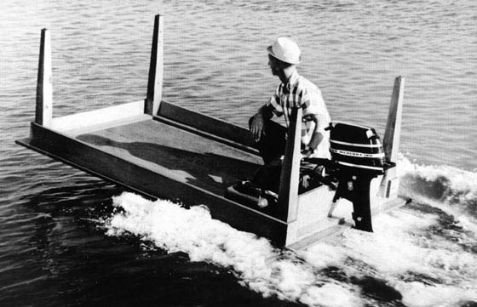
MAKE DO WITH LESS

Slide 26
MAKE DO WITH LESS

Slide 27

http://www.arb.ca.gov/msprog/ccbg/zev.htm
http://www.arb.ca.gov/msprog/ccbg/2002pc.htm
Super Ultra Low-Emission Vehicles (SULEV's)
Honda Accord gas
Civic GX CNG
Insight DX gas/IMA
Nissan Sentra CA gas
Toyota Prius gas/EA

Slide 28
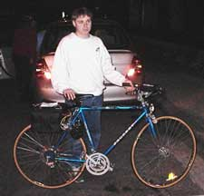
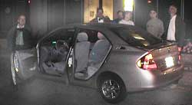
AIR POLLUTION
REDUCTION FROM
TOYOTA PRIUS TO
HOMEMADE
ELECTRIC BIKE

Slide 29
Under indulgence?

Slide 30
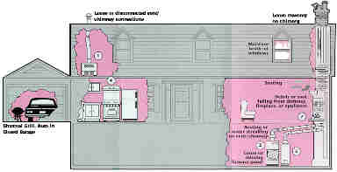
Indoor air pollution – some of the highest levels

Slide 31
Origin of the course
AIR POLLUTION CE524X
New course to be offered in Spring 2002
Jointly by Environmental and Transportation Engineering
Dr J(Hans) van Leeuwen and Dr Shauna Hallmark
Tel 294 5251; leeuwen@iastate.edu 294 5249; shallmar@iastate.edu Department of Civil and Construction Engineering 382 Town Engineering Building
Please register as soon as possible as enrollment is limited
o Air quality legislation. Sources of pollutants. Physics and chemistry of air pollution.
o Global warming - thermodynamics, heat balances, meteorological and geographic aspects, greenhouse effects and contribution of various gases.
o Ozone formation in the atmosphere and stratosphere.
Ozone destruction in the stratosphere, halons and freons.
o Air pollution control measures - filters, electrostatic precipitators, settling chambers, catalytic converters, scrubbing towers and their design, deep-sea disposal of CO₂.
o Measurement and energy equivalents of sound, noise abatement.
o Modeling air pollution for point sources. Regional air pollution modeling.
o Modeling transportation sources. Abatement of transportation related emissions.
o New technologies. New modeling techniques.

